Slide 1

Coding with AAUP
Free PowerPoint template
By: Hussein Younis
2023

Slide 2


Download Visual Studio Code:
https://code.visualstudio.com/

Slide 3

Prepare VS-code environment
https://code.visualstudio.com/docs

Slide 4


GitHub with VsCode
for Windows
GitHub account

Slide 5

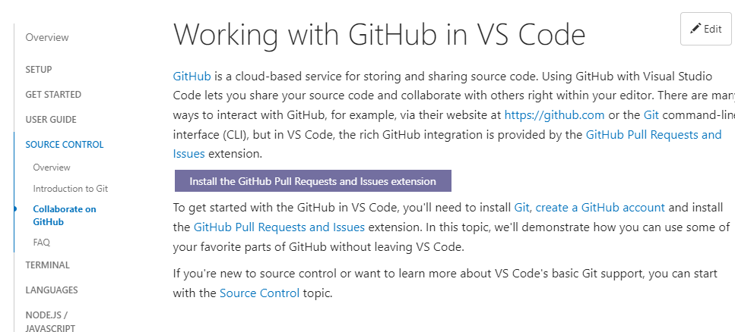
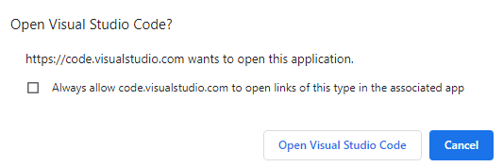
GitHub with VsCode
https://code.visualstudio.com/docs/sourcecontrol/github

Slide 6
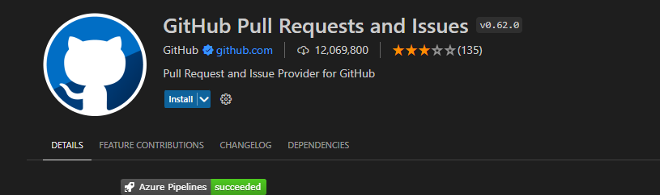
GitHub with VsCode
https://code.visualstudio.com/docs/sourcecontrol/github

Slide 7
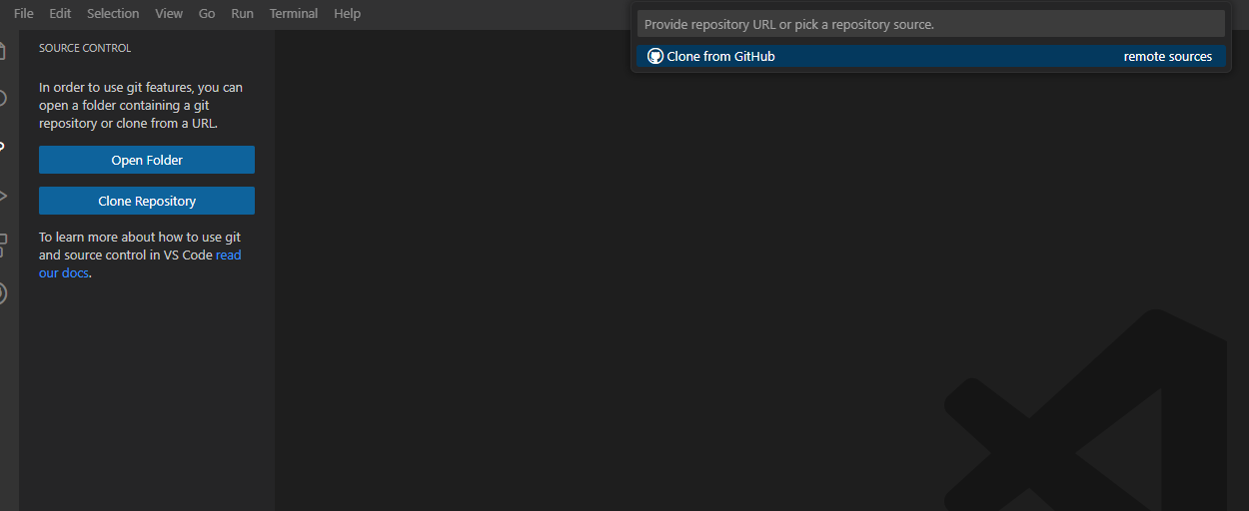
GitHub with VsCode
https://code.visualstudio.com/docs/sourcecontrol/github

Slide 8
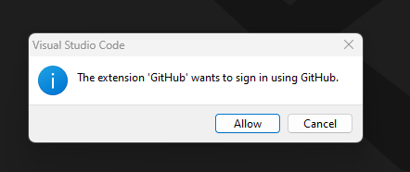
GitHub with VsCode
https://code.visualstudio.com/docs/sourcecontrol/github

Slide 9
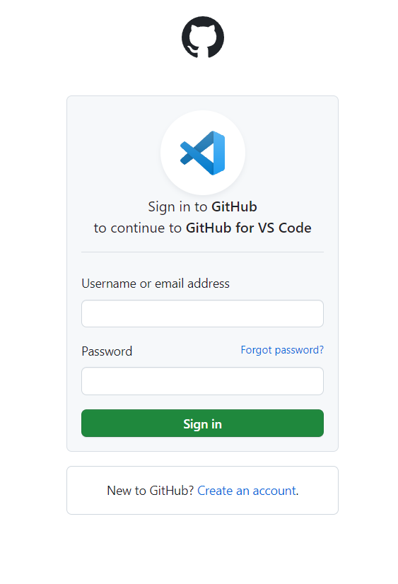
GitHub with VsCode
https://code.visualstudio.com/docs/sourcecontrol/github

Slide 10
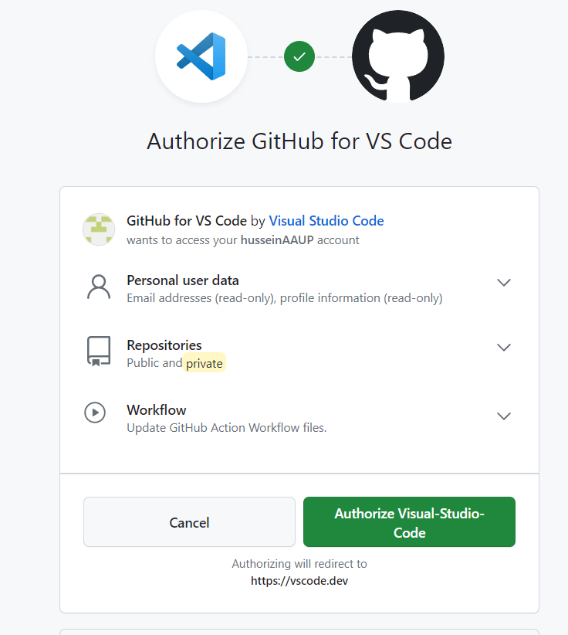
GitHub with VsCode
https://code.visualstudio.com/docs/sourcecontrol/github

Slide 11
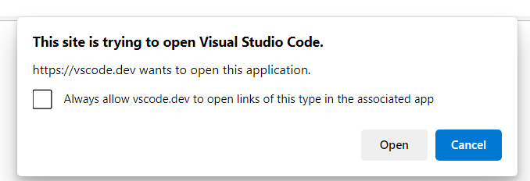
GitHub with VsCode
https://code.visualstudio.com/docs/sourcecontrol/github

Slide 12
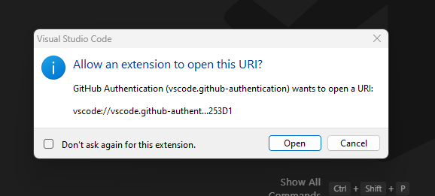
GitHub with VsCode
https://code.visualstudio.com/docs/sourcecontrol/github

Slide 13
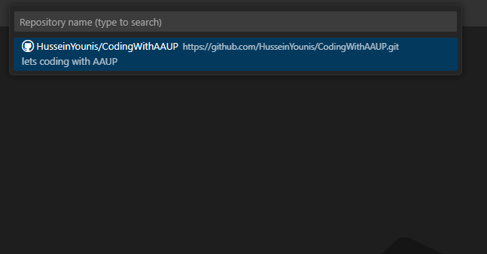
GitHub with VsCode
https://code.visualstudio.com/docs/sourcecontrol/github

Slide 14
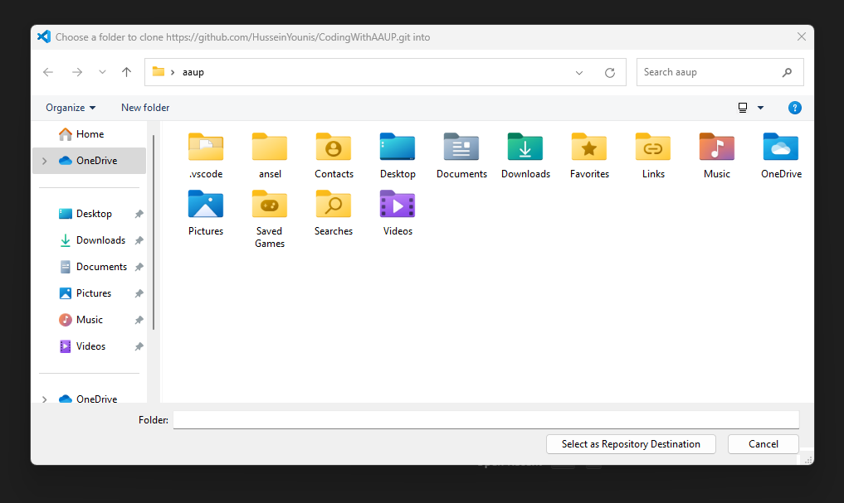
GitHub with VsCode
https://code.visualstudio.com/docs/sourcecontrol/github

Slide 15
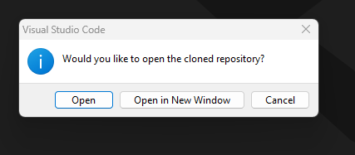
GitHub with VsCode
https://code.visualstudio.com/docs/sourcecontrol/github

Slide 16
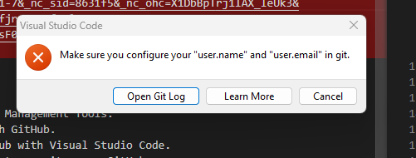
GitHub with VsCode
https://code.visualstudio.com/docs/sourcecontrol/github

Slide 17
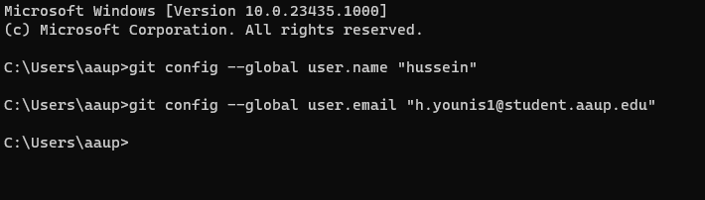
GitHub with VsCode
https://code.visualstudio.com/docs/sourcecontrol/github

Slide 18
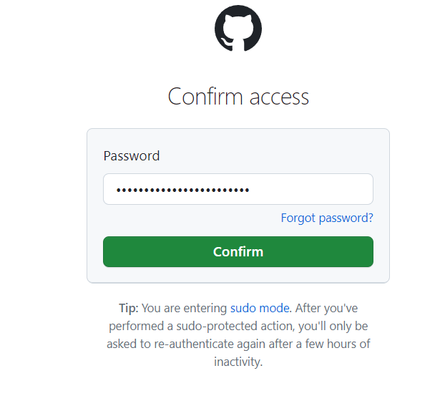
GitHub Desktop installation:
Fill in your password and then press confirm

Slide 19
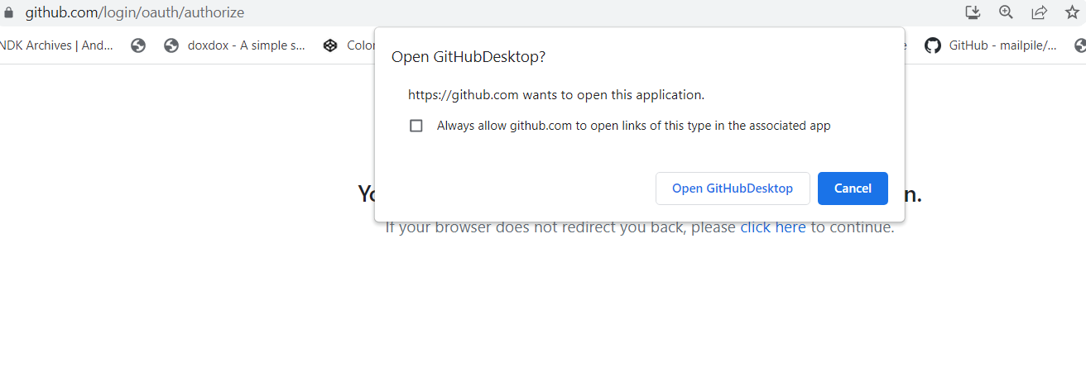
GitHub Desktop installation:
Click on open githubdesktop

Slide 20
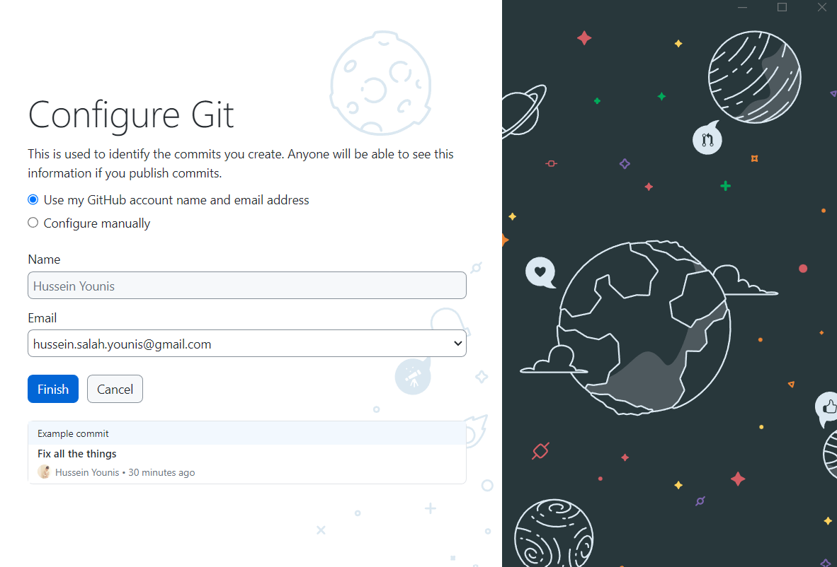
GitHub Desktop installation:
Click on finish

Slide 21
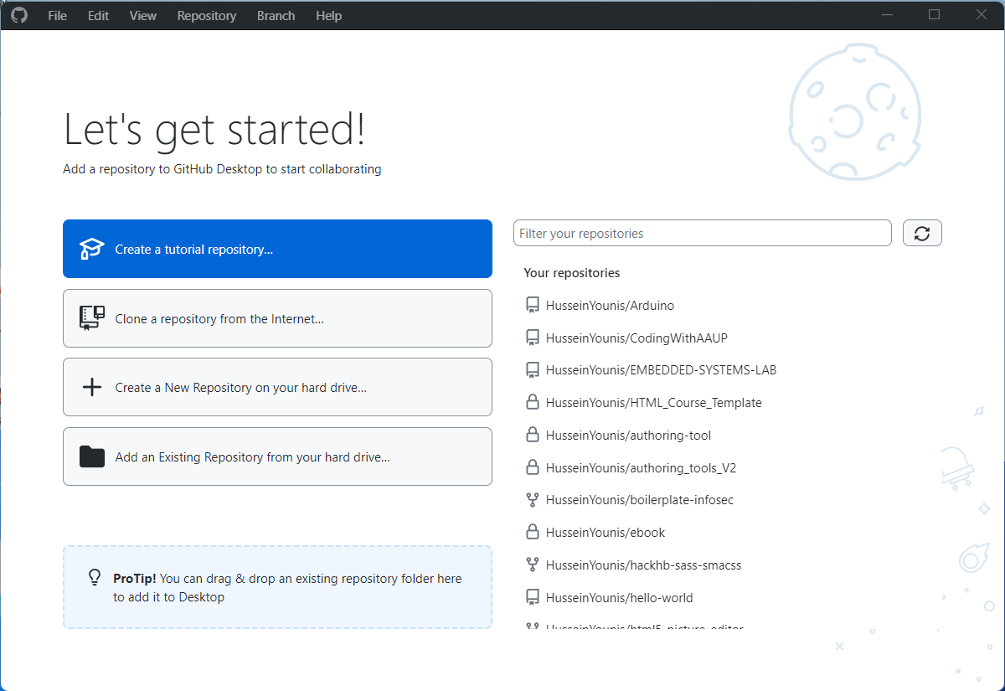
Lets get started!

